Slide 1
COMPUTER
Computer, device for processing, storing, and displaying information.
Computer once meant a person who did computations, but now the term almost universally refers to automated electronic machinery. The first section of this article focuses on modern digital electronic computers and their design, constituent parts, and applications. The second section covers t55he history of computing. For details on computer architecture, software, and theory, see computer science.

Slide 2
PARTS OF COMPUTER
HARDWARE SOFTWARE

Slide 3
HARDWARE
Memory address: Each device is assigned a binary number known as a unique identifier to trace memory location.
Interrupt Request Lines (IRQ): These are the hardware lines used to send interrupt signals to the microprocessor about a peripheral event. These configurations help manage various hardware operations.
Direct Memory Access (DMA) Channels: DMA is a pathway used by hardware devices to access, transfer, and share information directly from the main memory independent of the CPU.
Input/Output Port: These configurations are used to connect input and output devices to the computer with the help of memory addresses assigned to each port.

Slide 4
SOFTWARE
SYSTEM SOFTWARE APPLICATION SOFTWARE

Slide 5
SYSTEM SOFTWARE
OPERATING SYSTEM
WINDOWS
LINUX
MACOS

Slide 6
APPLICATION SOFTWARE
MS WORD
MS EXCEL
MS PAINT
NOTEPAD etc.

Slide 7
Computing basics
The first computers were used primarily for numerical calculations. However, as any information can be numerically encoded, people soon realized that computers are capable of general-purpose information processing. Their capacity to handle large amounts of data has extended the range and accuracy of weather forecasting. Their speed has allowed them to make decisions about routing telephone connections through a network and to control mechanical systems such as automobiles, nuclear reactors, and robotic surgical tools. They are also cheap enough to be embedded in everyday appliances and to make clothes dryers and rice cookers “smart.” Computers have allowed us to pose and answer questions that were difficult to pursue in the past. These questions might be about DNA sequences in genes, patterns of activity in a consumer market, or all the uses of a word in texts that have been stored in a database. Increasingly, computers can also learn and adapt as they operate by using processes such as machine learning.

Slide 8
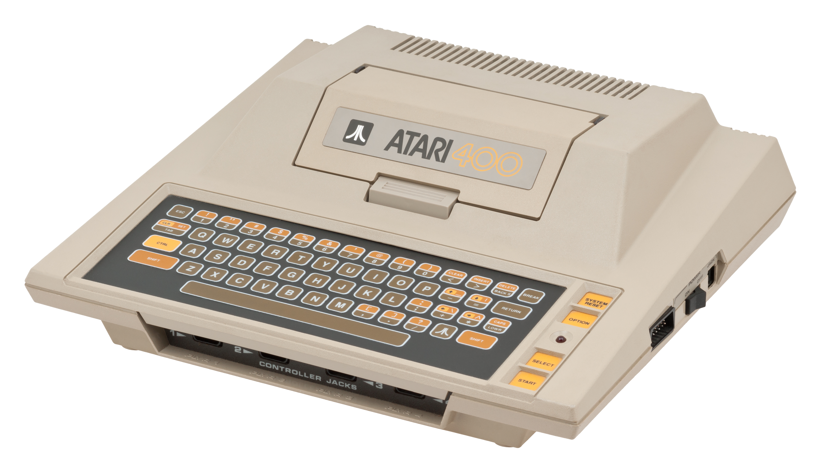
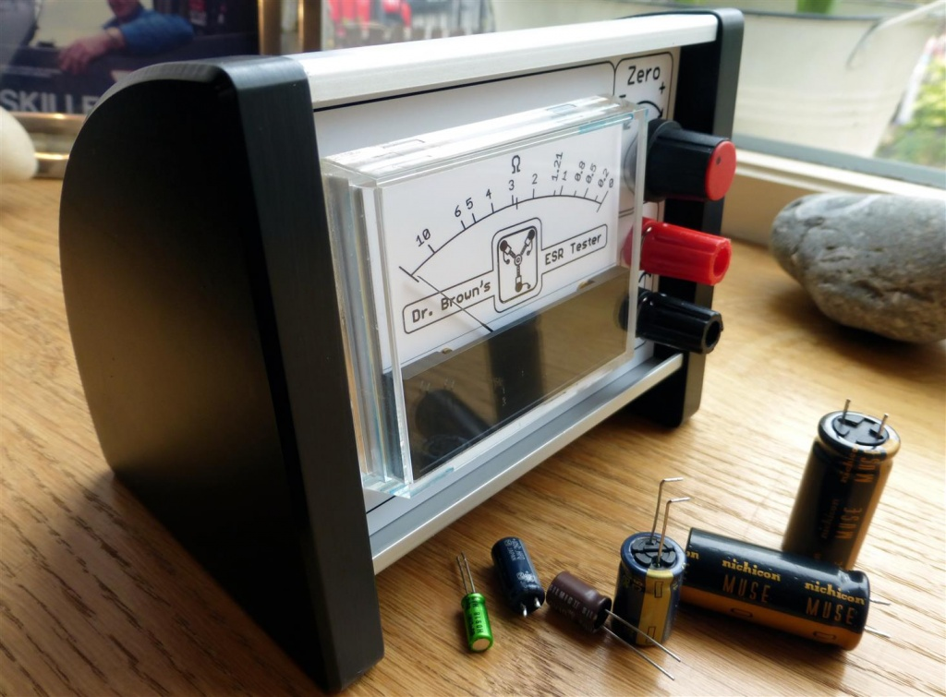
TYPES OF COMPUTER
ANALOG COMPUTER
DIGITAL COMPUTER
This Photo by Unknown Author is licensed under CC BY-SA
This Photo by Unknown Author is licensed under CC BY-SA

Slide 9
TYPES OF COMPUTER
.
Analog computers
Analog computers use continuous physical magnitudes to represent quantitative information. At first they represented quantities with mechanical components (see differential analyzer and integrator), but after World War II voltages were used; by the 1960s digital computers had largely replaced them. Nonetheless, analog computers, and some hybrid digital-analog systems, continued in use through the 1960s in tasks such as aircraft and spaceflight simulation.
One advantage of analog computation is that it may be relatively simple to design and build an analog computer to solve a single problem. Another advantage is that analog computers can frequently represent and solve a problem in “real time”; that is, the computation proceeds at the same rate as the system being modeled by it. Their main disadvantages are that analog representations are limited in precision.
Digital computers
In contrast to analog computers, digital computers represent information in discrete form, generally as sequences of 0s and 1s (binary digits, or bits). The modern era of digital computers began in the late 1930s and early 1940s in the United States, Britain, and Germany. The first devices used switches operated by electromagnets (relays). Their programs were stored on punched paper tape or cards, and they had limited internal data storage. For historical developments, see the section Invention of the modern computer

Slide 10
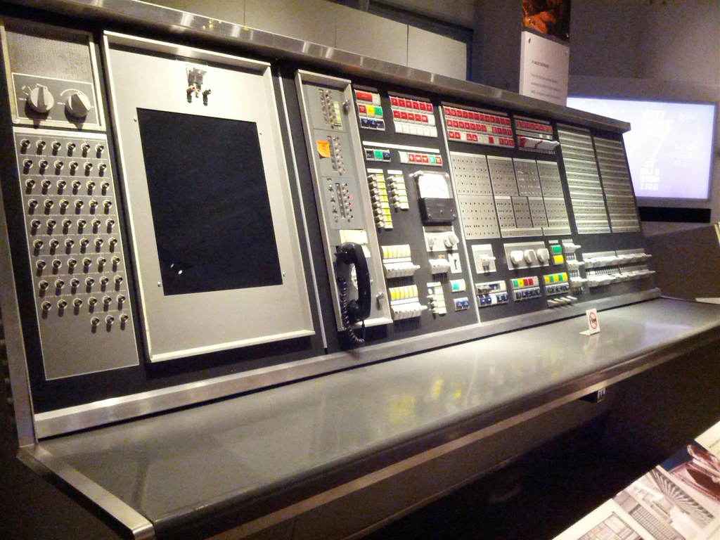
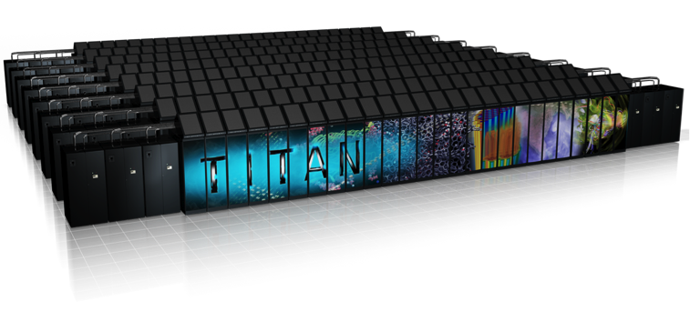
MAINFRAME COMPUTER
SUPER COMPUTER
This Photo by Unknown Author is licensed under CC BY-SA-NC
This Photo by Unknown Author is licensed under CC BY

Slide 11
Mainframe computer
During the 1950s and ’60s, Unisys (maker of the UNIVAC computer), International Business Machines Corporation (IBM), and other companies made large, expensive computers of increasing power. They were used by major corporations and government research laboratories, typically as the sole computer in the organization. In 1959 the IBM 1401 computer rented for $8,000 per month (early IBM machines were almost always leased rather than sold), and in 1964 the largest IBM S/360 computer cost several million dollars.
Supercomputer
The most powerful computers of the day have typically been called supercomputers. They have historically been very expensive and their use limited to high-priority computations for government-sponsored research, such as nuclear simulations and weather modeling. Today many of the computational techniques of early supercomputers are in common use in PCs. On the other hand, the design of costly, special-purpose processors for supercomputers has been replaced by the use of large arrays of commodity processors (from several dozen to over 8,000) operating in parallel over a high-speed communications network.

Slide 12
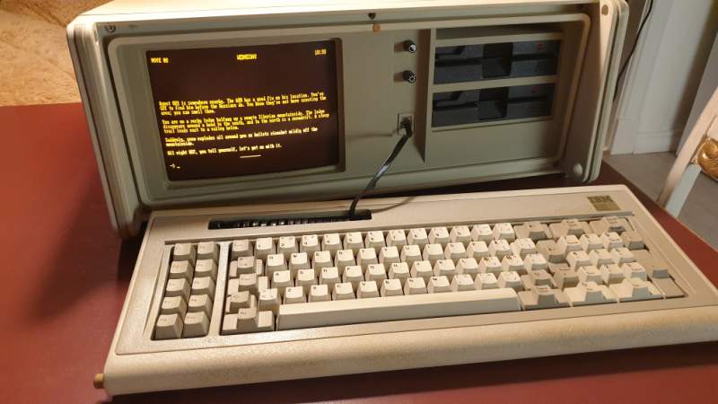
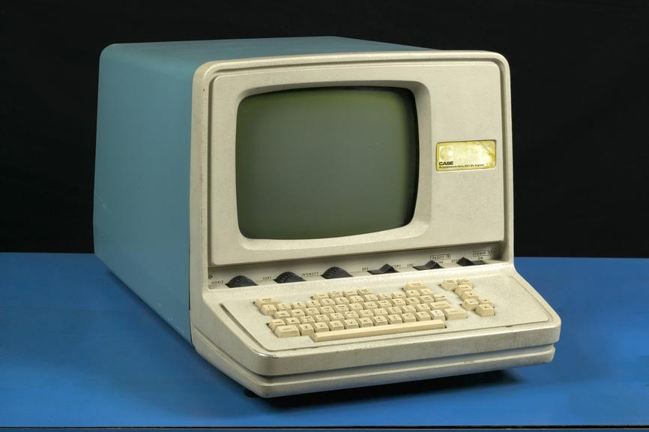
MINI COMPUTER
MICRO COMPUTER
This Photo by Unknown Author is licensed under CC BY
This Photo by Unknown Author is licensed under CC BY-NC-ND

Slide 13
Minicomputer
Although minicomputers date to the early 1950s, the term was introduced in the mid-1960s. Relatively small and inexpensive, minicomputers were typically used in a single department of an organization and often dedicated to one task or shared by a small group. Minicomputers generally had limited computational power, but they had excellent compatibility with various laboratory and industrial devices for collecting and inputting data.
Microcomputer
In the 1980s it was common to distinguish between microprocessor-based scientific workstations and personal computers. The former used the most powerful microprocessors available and had high-performance color graphics capabilities costing thousands of dollars. They were used by scientists for computation and data visualization and by engineers for computer-aided engineering. Today the distinction between workstation and PC has virtually vanished, with PCs having the power and display capability of workstations.

Slide 14

DIGITAL COMPUTER
The first true laptop computer marketed to consumers was the Osborne 1, which became available in April 1981. A laptop usually features a “clamshell” design, with a screen located on the upper lid and a keyboard on the lower lid. Such computers are powered by a battery, which can be recharged with alternating current (AC) power chargers

Slide 15
THANKYOU

